Slide 1


RF Genesis: Zero-Shot Generalization of mmWave Sensing through Simulation-Based Data Synthesis and Generative Diffusion Models
SenSys 2023
Xingyu Chen Xinyu Zhang
University of California San Diego
Notes:
Hi everyone,
my name is Xingyu Chen,
I am a second year PhD student at UC San Diego,
and am glad to be to present our work [Titile].

Slide 2
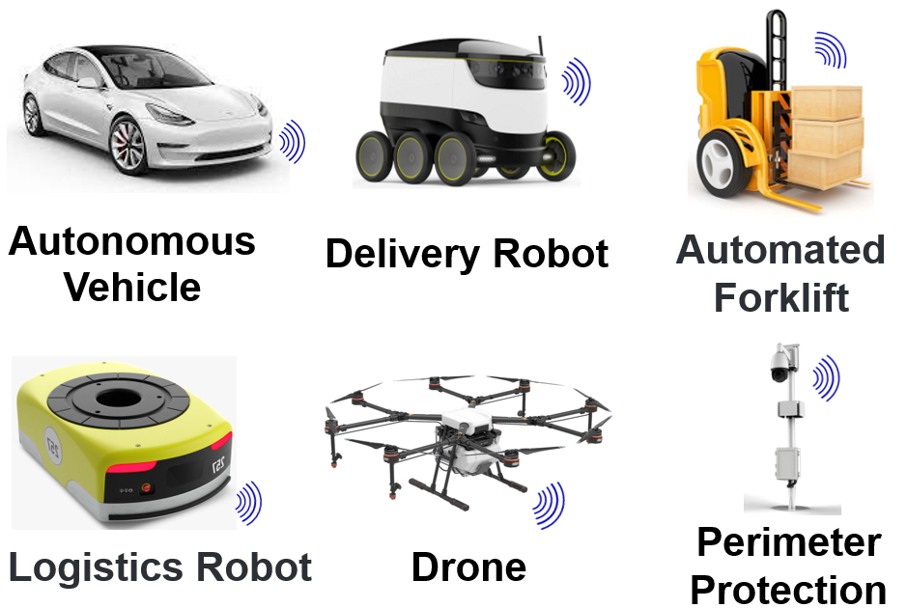
mmWave Sensing
Notes:
Millimeter wave (mmWave) sensing has been widely used in various applications such as self-driving cars, robotics, logistics, and security.
Recent applications demonstrate vision-like capabilities, such as gesture/posture tracking, person re-identification, and point cloud generation. These are often driven by deep learning models.
One common challenge for such applications lies in generalization.

Slide 3
Background & Motivation
Sensing System
Notes:
For example if we have deep learning based sensing systems for human activity reconigtion.

Slide 4
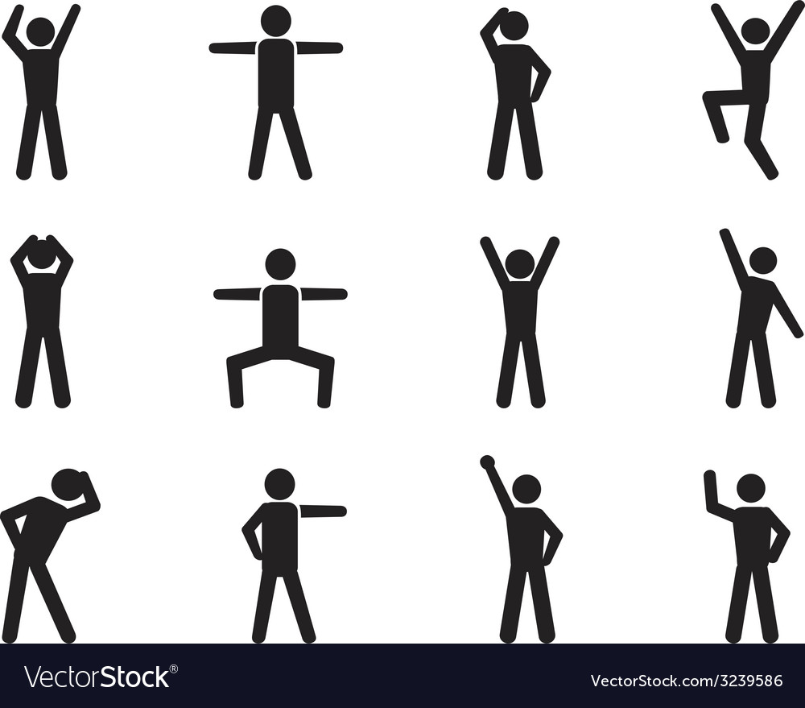
Background & Motivation
Sensing System
Training Data
Notes:
And it is trained on mmWave signal from a small set of basic human postures collected in lab setting.

Slide 5
Background & Motivation
Seen Cases
Accuracy: 95%
Sensing System
Training Data
Notes:
It may work well with postures that the system has already seen

Slide 6
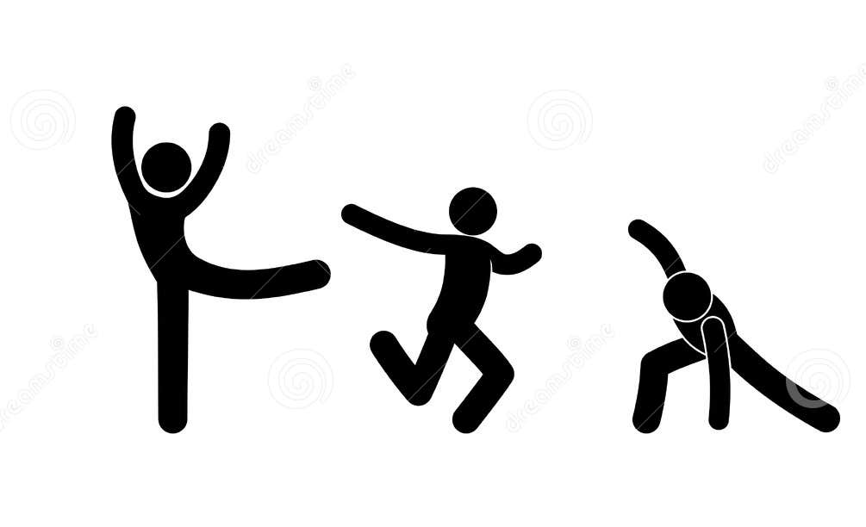
Background & Motivation
Seen Cases
Accuracy: 95%
Sensing System
Training Data
Accuracy: 35%
Unseen Cases
Generalization of mmWave sensing is a problem!
Notes:
However, it may not work well on unseen postures because the system only memorizes the seen postures and hard to learn the true distribution of human reflection of mmWave signals.

Slide 7

Straightforward Solution of Generalization:
Increase the size and diversity of the dataset.
Training
Data Driven
mmWave Sensing Systems
Cost
Data
Notes:
One straightforward solution to this problem is to increase the size and diversity of the training dataset.
If our dataset covers various variations of posture, it might be sufficient for practical applications.
However, increasing the dataset is not easy, and it can be costly and often impractical.

Slide 8
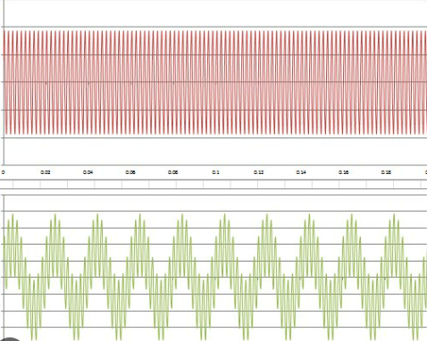
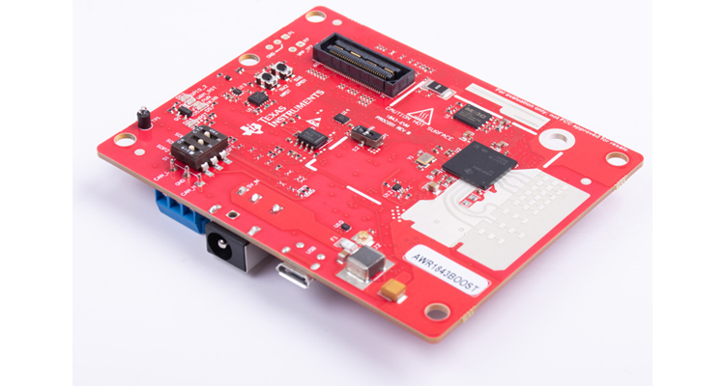
mmWave Data Collection
mmWave data is unique
Short wavelength
Sensitive to tiny changes
Coherent combination of multipath reflections
2Tx 4Tx
Bandwidth 0.7GHz
Slope 29 MHz/us …
3Tx 4Rx
Bandwidth 2GHz,
Slope 60 MHz/us …
$400
Notes:
This is because collecting mmWave data requires specialized equipment and professional knowledge to operate. These resources are usually expensive and not accessible.
Moreover, since mmWave is Sensitive to tiny changes, Different radar device and configuration would leads to completely different signals.
Therefore the data collected is difficult to transfer from one application to another, and this prevents us to have large open source dataset like computer vision.

Slide 9
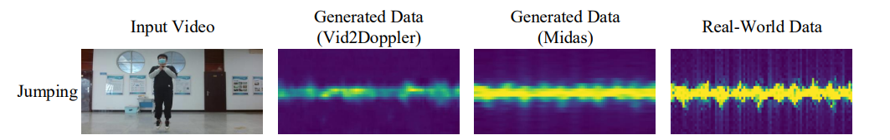
Related Works: Cross-modal Data Synthesis
Prior Works
Midas: Generating mmWave Radar Data from Videos for Training Pervasive and Privacy-preserving Human Sensing Tasks
Notes:
Previous attempts have aimed to transfer video datasets into RF datasets using simulators.
However, these methods are still limited by the availability of vision datasets, and they have constraints on the types of objects they can handle. Additionally, they heavily rely on the accuracy of the 3D reconstruction algorithm used to construct the 3D mesh model from input video

Slide 10
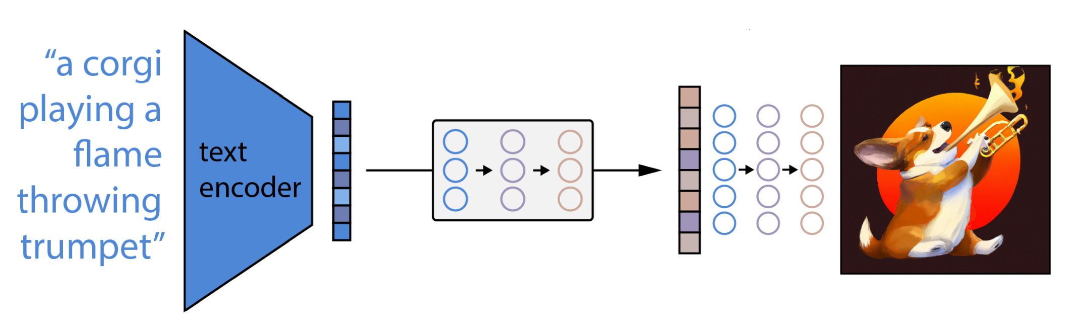
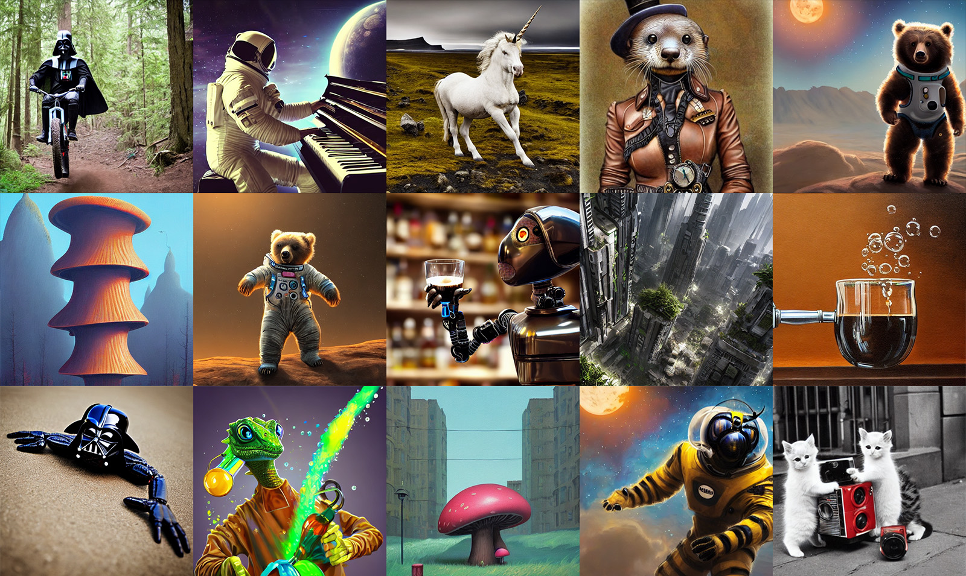
Related Works: Generative Diffusion Models
Stable Diffusion
Midjourney
Notes:
Diffusion models are emerging generative models that capture real distributions of samples and can generate diverse kinds of outputs.
They have already been used in commercial products like Stable Diffusion and Midjourney.
However, there is a noticeable gap in research regarding the applications of diffusion models in the RF domain.
We are taking a significant step in identifying the significance of diffusion models in overcoming the generalization problem in wireless sensing

Slide 11
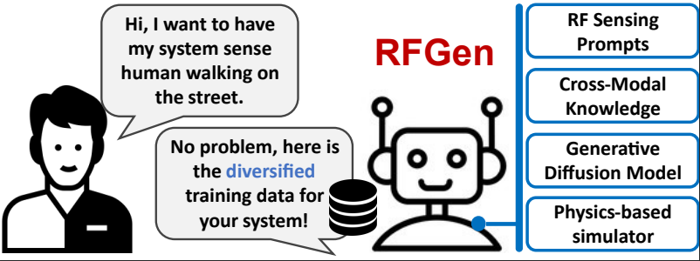
Contribution
Transitioning and expanding existing vision/graphics datasets to the wireless sensing domain
Notes:
Here, we propose RFGen,
a novel and generic solution for transitioning and expanding existing vision/graphics datasets into the wireless sensing domain.

Slide 12
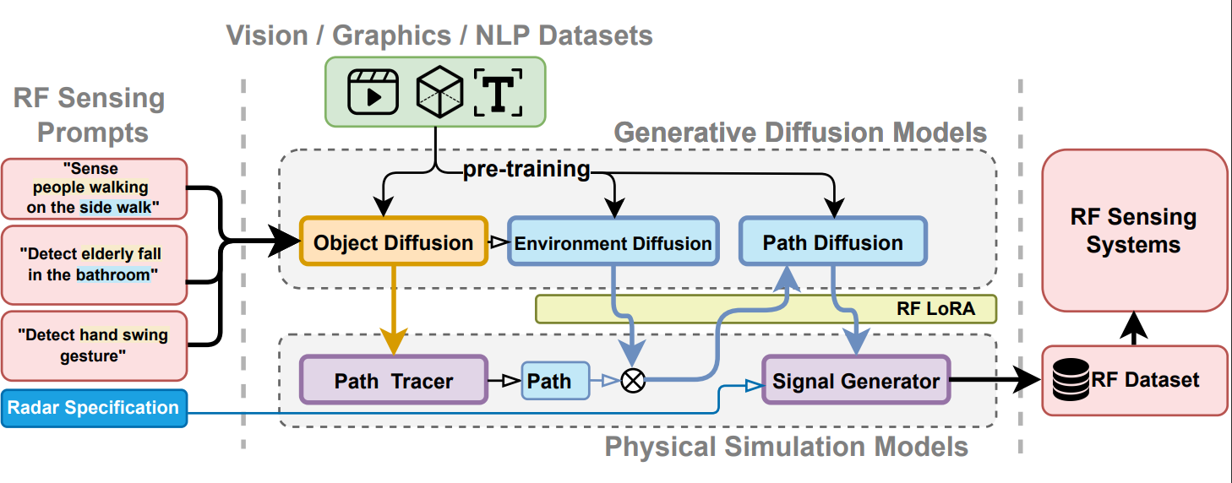
System Design
Notes:
Here is our system design

Slide 13
System Design
Notes:
the input consists of RF sensing prompts,
which define the target sensing application in plain text and outline the potential actions of the target and its environment.
The output is a synthesized dataset.

Slide 14
System Design
Notes:
RFGen initially processes the prompts using an Object Diffusion model.
This models, based on its pre-trained knowledge, generates a diverse range of object motions and 3D mesh models.
Simultaneously, the prompts are processed by an Environment Diffusion model, which generates various representations of environmental multipaths.
The path-traced and diffused multipath data are then fused by the Path Diffusion model to further enhance realism

Slide 15
System Design
Notes:
We also employ physical simulation methods based on ray tracing

Slide 16
System Design
Notes:
RFGen operates on a hybrid model that merges white-box physical law models with black-box deep learning models.
This reconciliation is enabled by RF LoRA as the communication layer.

Slide 17
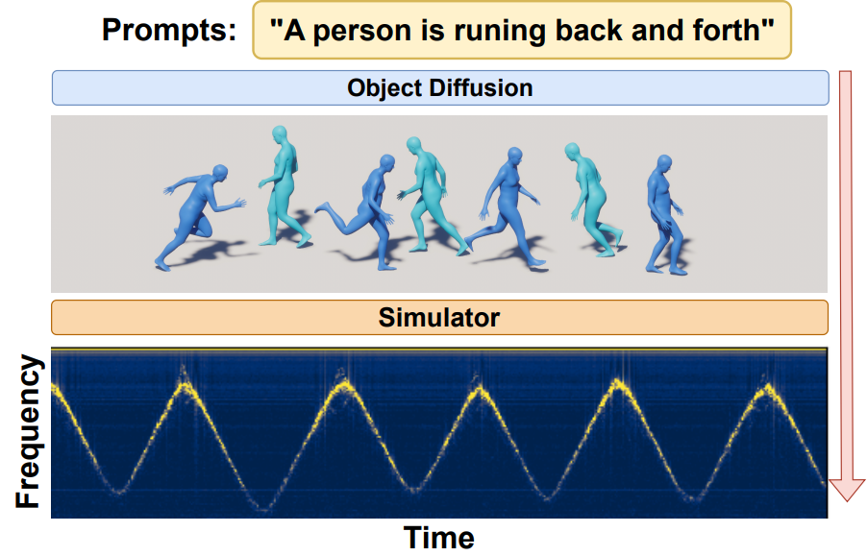
Object Diffusion
Notes:
The object diffusion model takes the prompts as input and outputs the target object with the corresponding motion that can be directly used by the simulator.

Slide 18
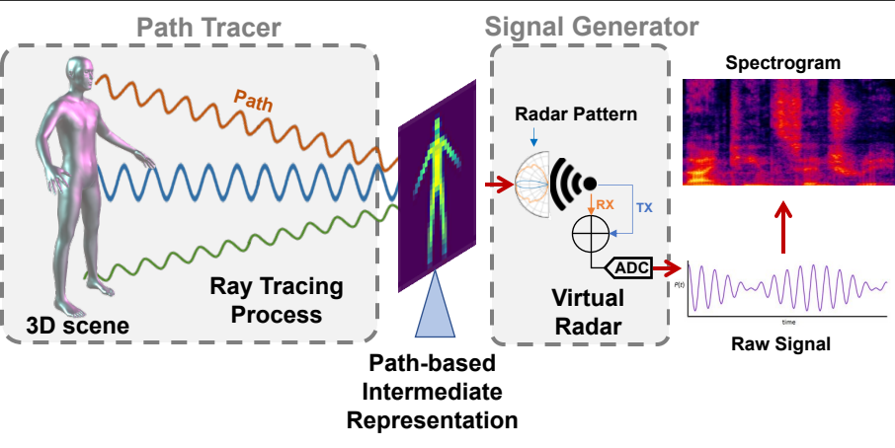
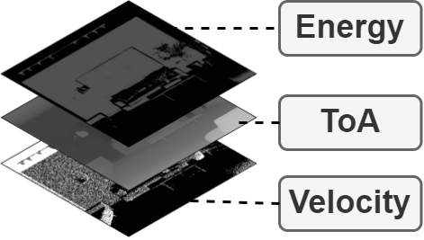
Physical – Diffusion Communication and Integration
PIR: Path Based Intermediate Representation of the RF Ray Tracing process
Notes:
To integrate the ray tracing models with the image-based diffusion, we extract intermediate information from the ray tracing process, specifically the Path-based Intermediate Representation (PIR).
This format of scene presentation resembles an image, but instead of red, green, and blue color channels,
it contains information about energy, time of arrival, and velocity of the ray tracing paths.
The PIR serves as an image-like representation of the simulated scene for ray tracing and is independent of the radar hardware

Slide 19
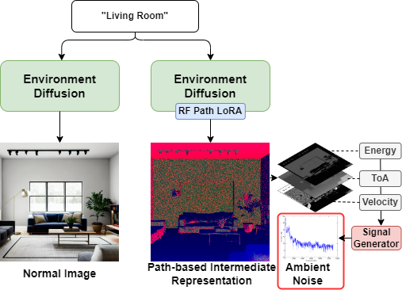
Environment Diffusion
Environment Diffusion
A pre trained text2img model
RF Path LoRA (Low Rank Adaptation)
Fine tunes pretrained model to PIR format
By injecting trainable layers to each transformer block
Notes:
We use a pretrained image generation model as our environment model, and we fine-tune it using RF Path LoRA.
These RF Path LoRA are trainable layers that injected into the Diffusion model, and we tune the model by training it with simulated PIR data from open 3D datasets.
The fine-tuned image generation model captures multipath noise, which can impact the generalization of RF sensing systems across different environments

Slide 20
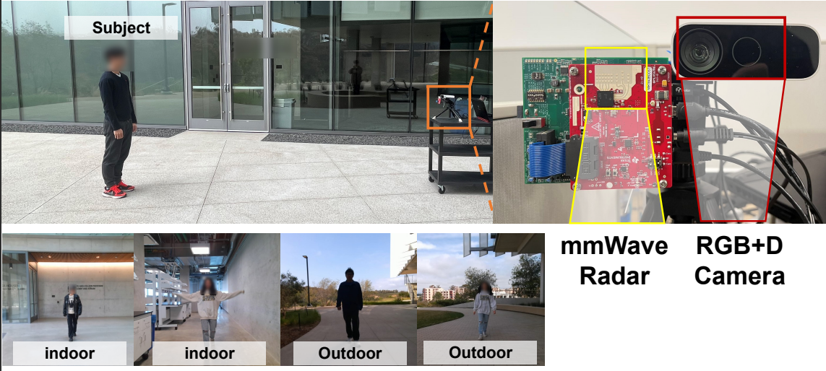
Evaluation - Setup
Notes:
We evaluated RFGen in real-world applications by collecting real radar signal data and using a depth camera as ground truth.
The data were collected in both indoor and outdoor environments, involving multiple participants with varying genders and body shapes.

Slide 21
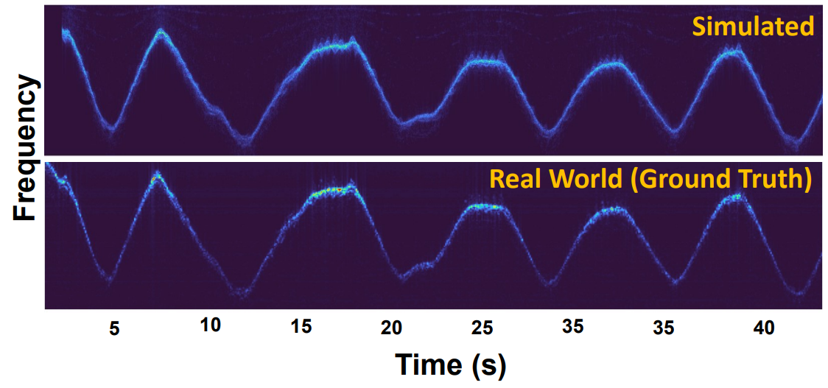
Evaluation - Simulator
The simulation is accurate in Temporal / Spectral Levels
Avg SSIM = 0.96
Notes:
To evaluate the accuracy of our simulator, we used the 3D mesh reconstructed from a depth camera as input.
The results show a structural similarity of 0.96 between simulated signals and real signals.
Here is an example of the mmWave spectrogram for a person walking back and forth.

Slide 22
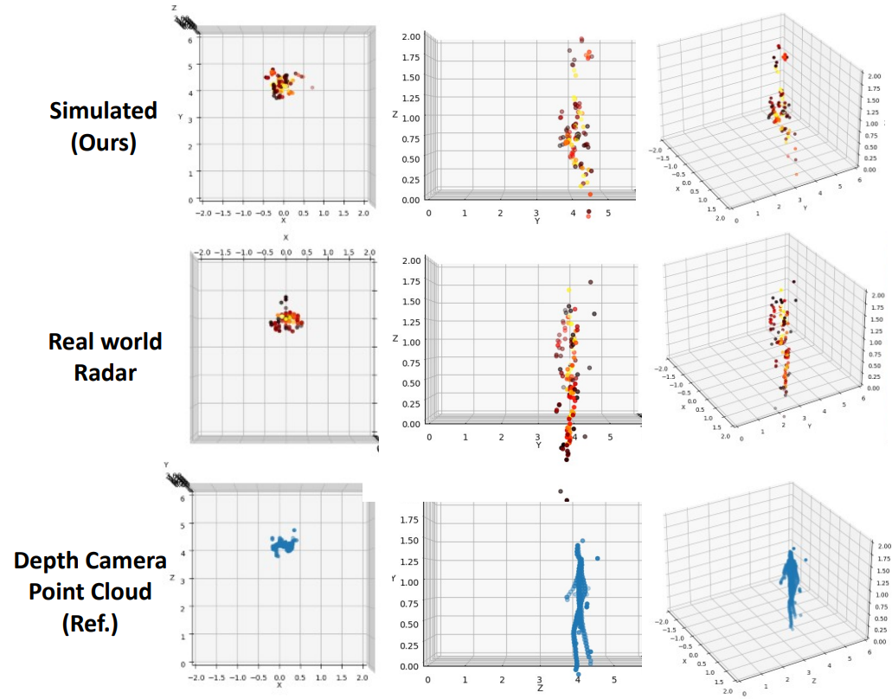
Evaluation - Simulator
The simulation is accurate in point cloud levels
Notes:
We conducted a similar evaluation at the point cloud level.
As shown in the figure, the simulated point cloud closely resembles the ground truth and achieves low point cloud error.

Slide 23
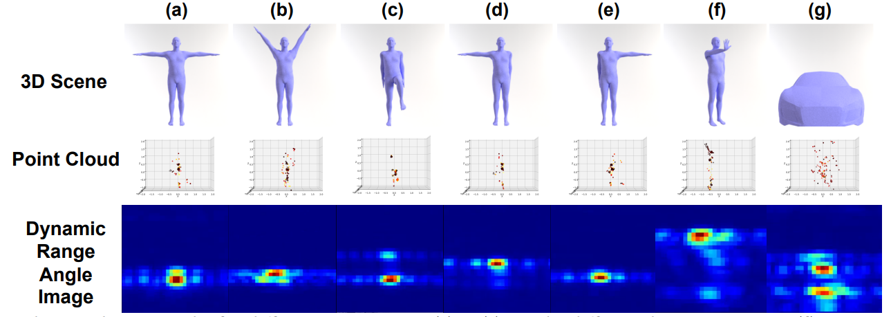
Evaluation - Simulator
RF Gen’s Simulator supports various kind of objects.
It outputs RAW radar signal and capable of different kinds of processing
Notes:
Our simulator is generic and supports various object models.
The simulator outputs format is identical to those of real radar hardware, allowing us to apply the same signal processing methods for downstream systems.

Slide 24
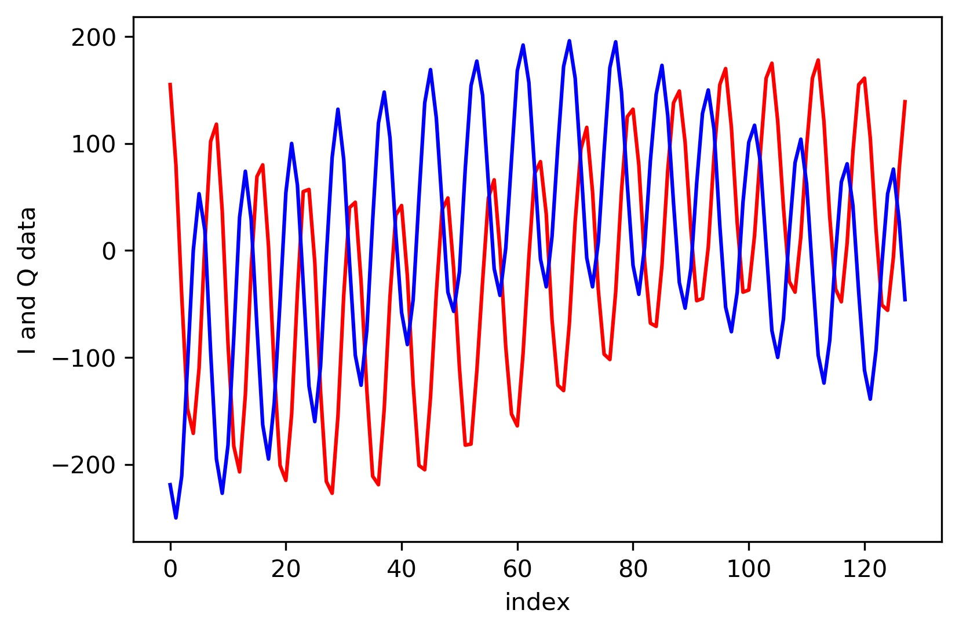
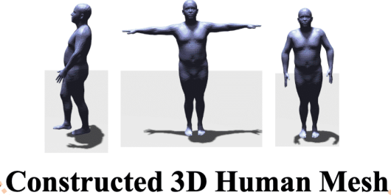
End-to-End Evaluation: Posture Estimation
Credit: mmMesh: Towards 3D Real-Time Dynamic Human Mesh Construction Using Millimeter-Wave
Notes:
We conducted an end-to-end evaluation to assess whether RFGen can improve generalization. Here, we demonstrate its application in human posture estimation, essentially constructing a 3D model mesh from radar signals.

Slide 25
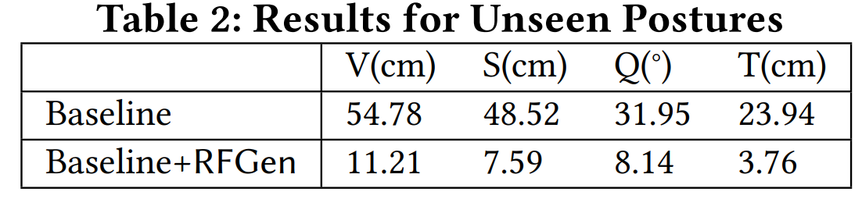
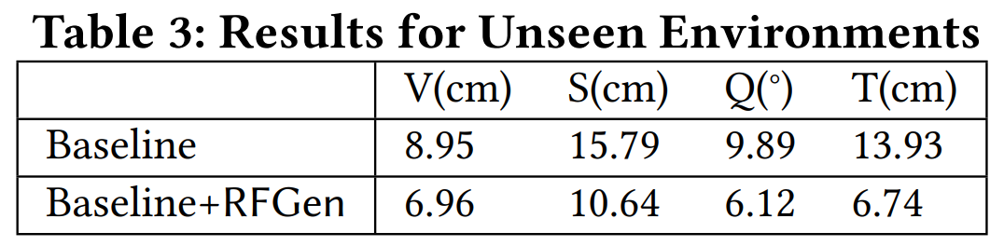
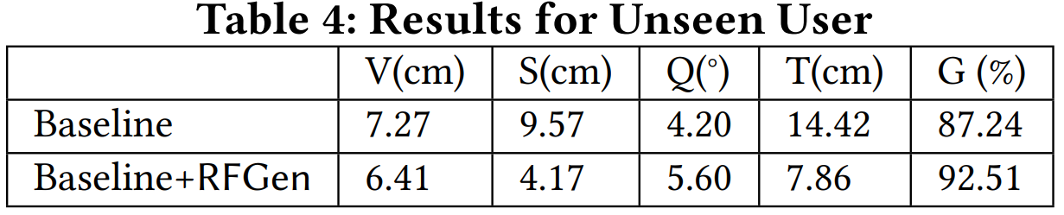
End-to-End Evaluation: Posture Estimation
Unseen Postures,
Unseen Environments,
Unseen User (Body shapes)
V: Average Vertex Error
S: Average Joint Localization Error
Q: Average Joint Rotation Error
T: Mesh Localization Error
G: Gender Prediction Accuracy
Notes:
We found that the current system struggles with unseen data, such as unseen postures, environments, and body shapes.
However, by training with synthesized data from RFGen, we can significantly improve the performance of human posture estimation

Slide 26
End-to-End Evaluation: Hand Gesture Recognition
Same Gestures at different orientations
A
B
Notes:
We also found similar generalization problems in hand gesture recognition systems.
These systems often struggle to recognize the same gestures at different orientations.
For instance, if the training data includes the thumbs-up gesture in orientation A,
the system may fail to recognize it in orientation B due to variations in mmWave reflection features.

Slide 27
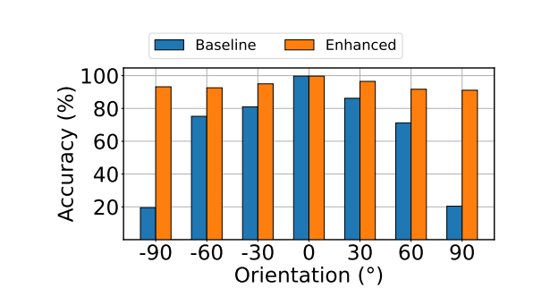
End-to-End Evaluation: Hand Gesture Recognition
Enhancing Gestures Recognition Performance at different orientations
Notes:
Luckly, with the assistance of RFGen, we can generate gesture data at various viewing angles in the simulation,
thereby improving generalization across different orientations.

Slide 28
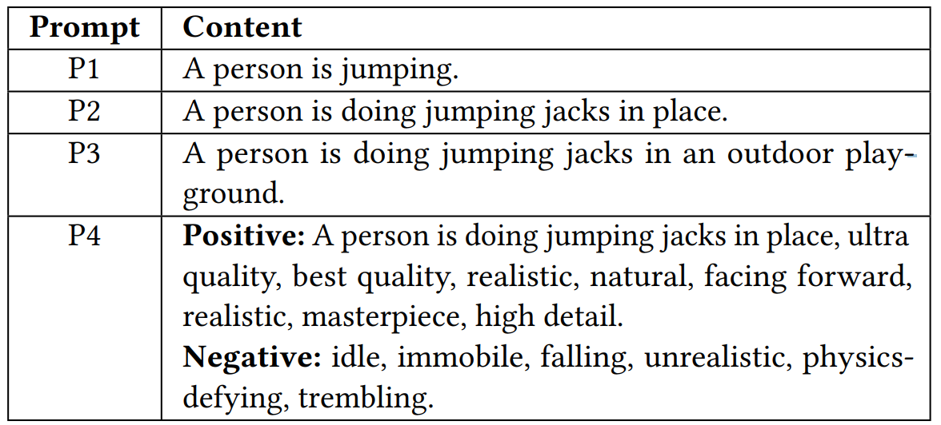
Impact of Quality of Prompts
94.3%,
94.9%,
95.0%,
98.2%,
Notes:
Since RFGen is based on a generative model that takes prompts as input, we conducted a micro-benchmark of prompt quality.
For example, when recognizing a human jumping, we observed that providing a more detailed and precise description of the target posture leads to better results.
Additionally, using general terms like 'best quality' and defining negative prompts also proved beneficial. Negative prompts describe results we do not want.

Slide 29
Conclusion
RFGen
A mmWave sensing data synthesis framework
High-precision ray tracing simulator + cross modal generative diffusion model
Demonstrates a remarkable enhancement in sensing and generalization.

